Slide 1
Locality Sensitive Hashing
Ruhollah Shemirani

Slide 2
Applications
Duplicate Items, Mirror websites
Entity Linkage, Similar Documents
Nearest Neighbor Search
Query Handling

Slide 3
Problems
Linear with respect to feature space
Quadratic growth with number of queries
Curse of Dimensionality
Notes:
􏰑􏰊􏰑 􏰓 􏰅􏰋/􏰆 ≈ 5*10^11 comparisons 􏰁 At 105 secs/day and 106 comparisons/sec,
it would take 5 days

Slide 4
Normal Hash Functions
Variable sized bit streams to fixed size bit streams.
Uniform distribution over range is usually desired.

Slide 5
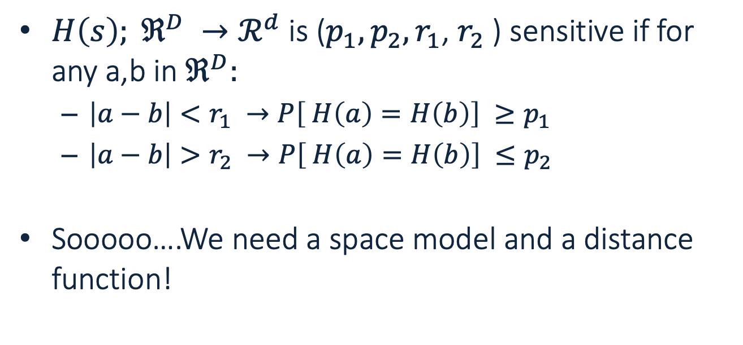
Locality Sensitive Hash Functions
$H\left(s\right); ℜ^{D} →ℛ^{d}$ is ($p_{1},p_{2},r_{1}$, $r_{2}$) sensitive if for any a,b in $ℜ^{D}:$
$\left|a−b\right|<r_{1} →P\left[ H\left(a\right)=H\left(b\right)\right] ≥p_{1}$
$\left|a−b\right|>r_{2} →P\left[ H\left(a\right)=H\left(b\right)\right] ≤p_{2}$
Sooooo….We need a space model and a distance function!

Slide 6
Similarity of Documents

Slide 7
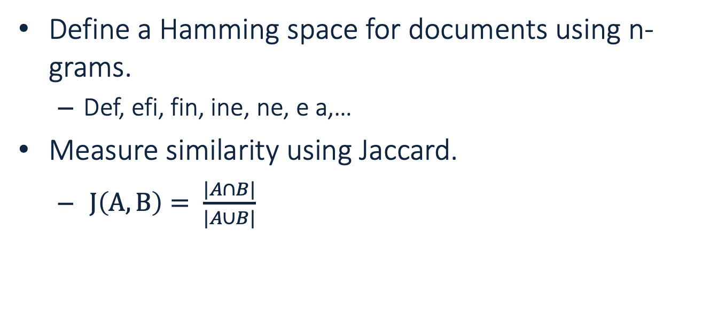
Space and Distance
Define a Hamming space for documents using n-grams.
Def, efi, fin, ine, ne, e a,…
Measure similarity using Jaccard.
$J\left(A,B\right)= \frac{|A∩B|}{|A∪B|}$

Slide 8
A Special Case of LSH
Adapted From Mining of Massive Datasets by Jure Leskovec, Anand Rajaraman, Jeff Ullman
http://www.mmds.org

Slide 9
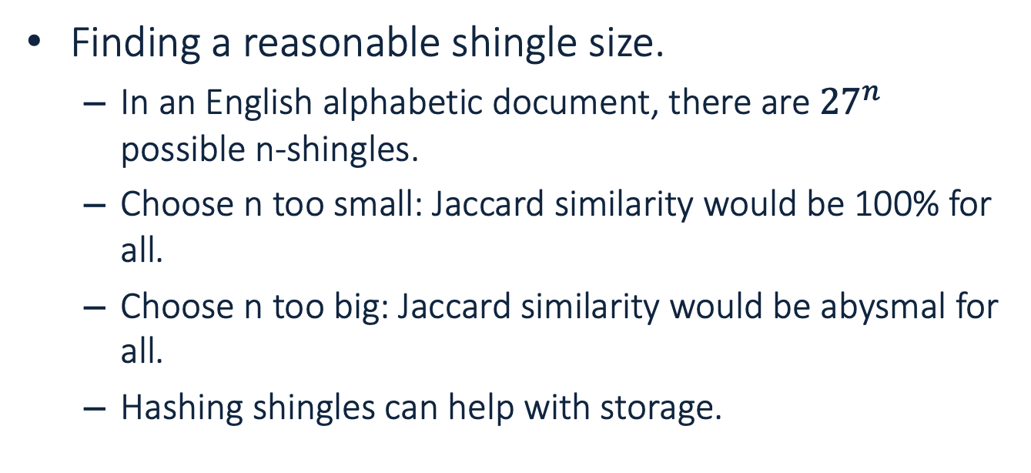
Shingling
Finding a reasonable shingle size.
In an English alphabetic document, there are ${27}^{n}$ possible n-shingles.
Choose n too small: Jaccard similarity would be 100% for all.
Choose n too big: Jaccard similarity would be abysmal for all.
Hashing shingles can help with storage.

Slide 10
Document Representation
Represent Documents as vectors in Hamming space.
1 if a document includes a s(h?)ingle value, 0 if not.
Saves disk space.
How is it related to Jaccard?
Shingles | D₁ | D₂ | D₃ | D₄
S₁ | 1 | 0 | 0 | 1
S₂ | 0 | 0 | 1 | 0
S₃ | 0 | 1 | 0 | 1
S₄ | 1 | 0 | 1 | 1
S₅ | 0 | 0 | 1 | 0

Slide 11
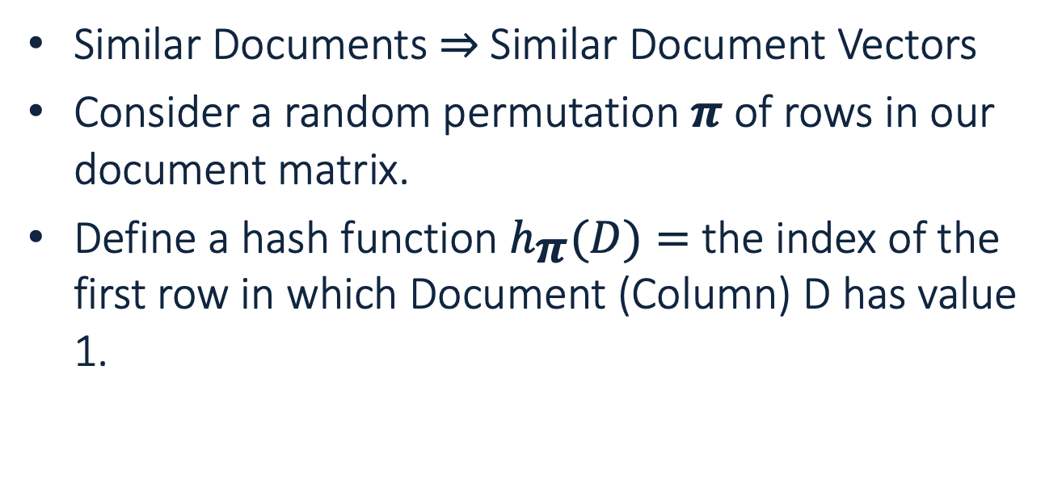
Choosing a Hash Function
Similar Documents ⇒ Similar Document Vectors
Consider a random permutation 𝝅 of rows in our document matrix.
Define a hash function $h_{\text{π}}(D)=$the index of the first row in which Document (Column) D has value 1.

Slide 12
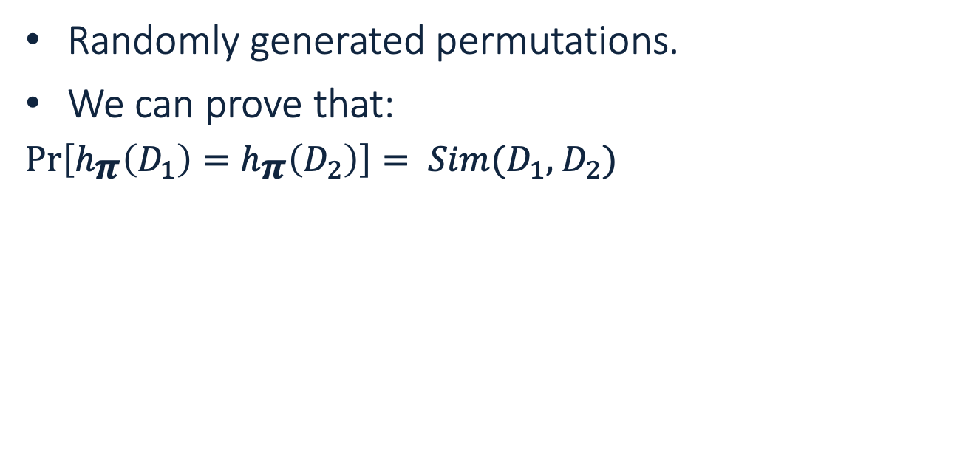
Minhashing
Randomly generated permutations.
We can prove that:
$\operatorname{Pr}\left[h_{\text{π}}\left(D_{1}\right)=h_{\text{π}}\left(D_{2}\right)\right]= Sim(D_{1},$ $D_{2})$
P1 | D₁ | D₂ | D₃ | D₄
S₂ | 0 | 0 | 1 | 0
S₅ | 0 | 0 | 1 | 0
S₁ | 1 | 0 | 0 | 1
S₄ | 1 | 0 | 1 | 1
S₃ | 0 | 1 | 0 | 1

Slide 13
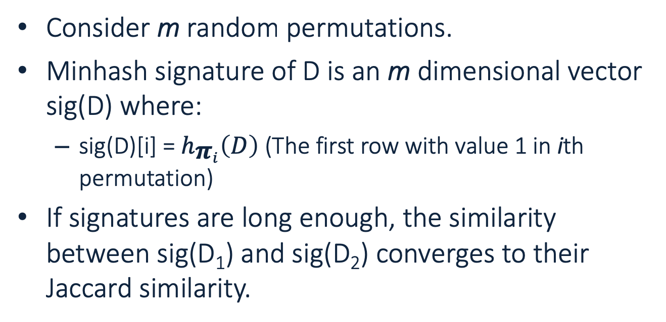
Minhash Signatures
Consider m random permutations.
Minhash signature of D is an m dimensional vector sig(D) where:
sig(D)[i] = $h_{{\text{π}}_{i}}\left(D\right)$ (The first row with value 1 in ith permutation)
If signatures are long enough, the similarity between sig(D₁) and sig(D₂) converges to their Jaccard similarity.

Slide 14
Minhash Signatures
We just compressed a text document D into sig(D).
Can we go further?
P1 | D₁ | D₂ | D₃ | D₄
H₁ | 1 | 3 | 0 | 1
H₂ | 0 | 2 | 0 | 0

Slide 15
More Compression!
OK! But Why?
Elimination of O(N²) comparison of documents.
Filter out dissimilar documents.
OK! But How?
Filter out all non similar pairs. Just examine the ones that are similar.
Only check a pair if they share a fraction of their Minhash Signatures.

Slide 16
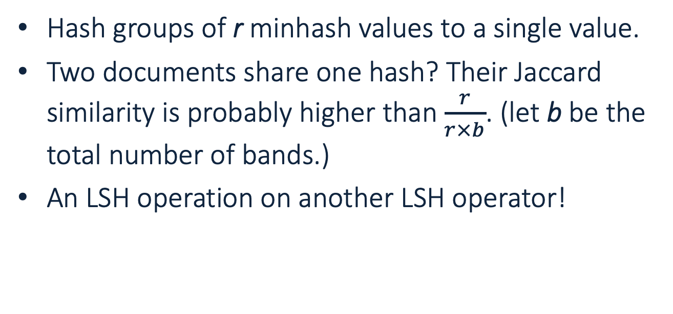
LSH
Hash groups of r minhash values to a single value.
Two documents share one hash? Their Jaccard similarity is probably higher than $\frac{r}{r×b}$. (let b be the total number of bands.)
An LSH operation on another LSH operator!

Slide 17
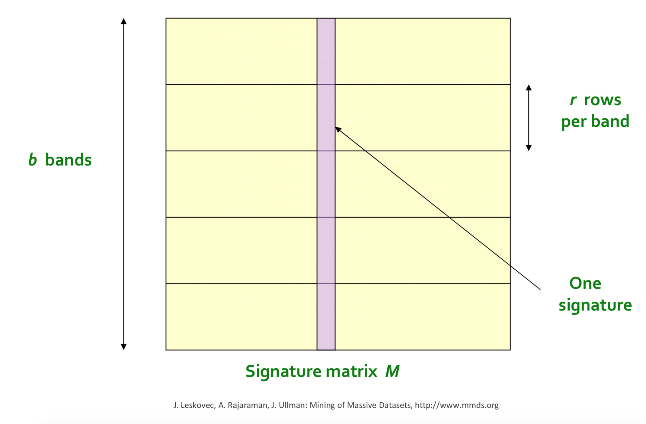
LSH

Slide 18
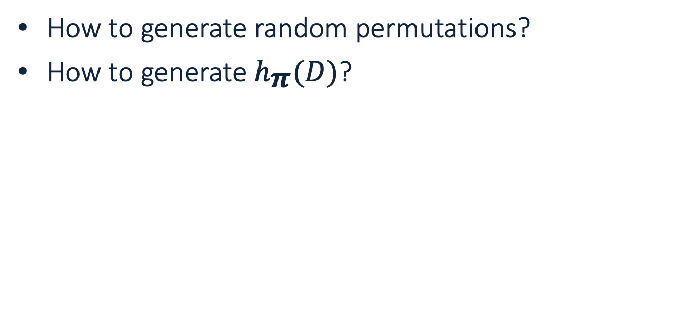
Some Technical Notes
How to generate random permutations?
How to generate $h_{\text{π}}(D)$?

